Slide 1

COVID-19
Crisis in India

Slide 2
Context
Coronaviruses are a large family of viruses which may cause illness in animals or humans. In humans, several coronaviruses are known to cause respiratory infections ranging from the common cold to more severe diseases such as Middle East Respiratory Syndrome (MERS) and Severe Acute Respiratory Syndrome (SARS). The most recently discovered coronavirus causes coronavirus disease COVID-19 - World Health Organization
The number of new cases are increasing day by day around the world. This dataset has information from the states and union territories of India at daily level.
State level data comes from Ministry of Health & Family Welfare
Testing data and vaccination data comes from covid19india. Huge thanks to them for their efforts!
Update on April 20, 2021: Thanks to the Team at ISIBang, I was able to get the historical data for the periods that I missed to collect and updated the csv file.

Slide 3
Content
COVID-19 cases at daily level is present in covid_19_india.csv file
State wise testing details in StatewiseTestingDetails.csv file
Travel history dataset by @dheerajmpai - https://www.kaggle.com/dheerajmpai/covidindiatravelhistory

Slide 4
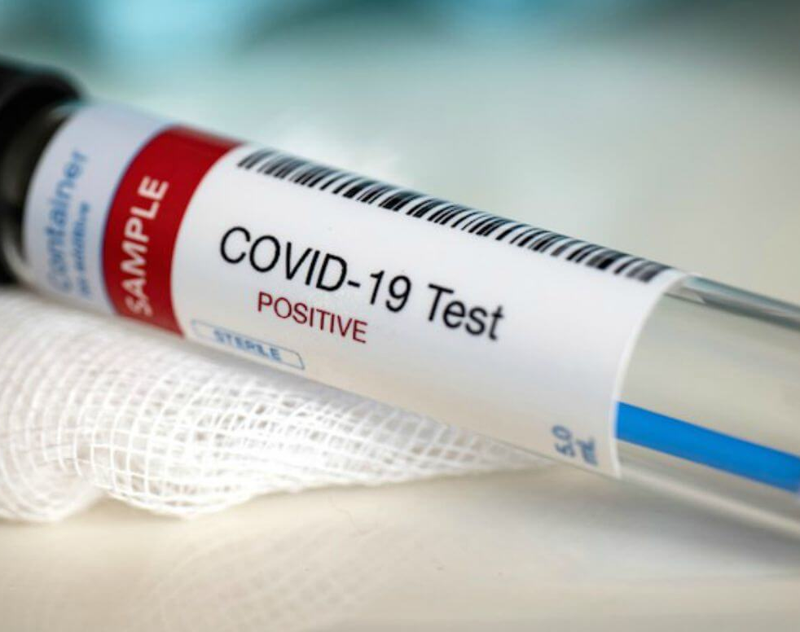
State wise Testing details in India
*Top/bottom 10 states with highest number of Total Samples.
*Top/bottom 10 states with highest number of Positive cases.
*Top/bottom 10 states with highest number of Negative cases

Slide 5
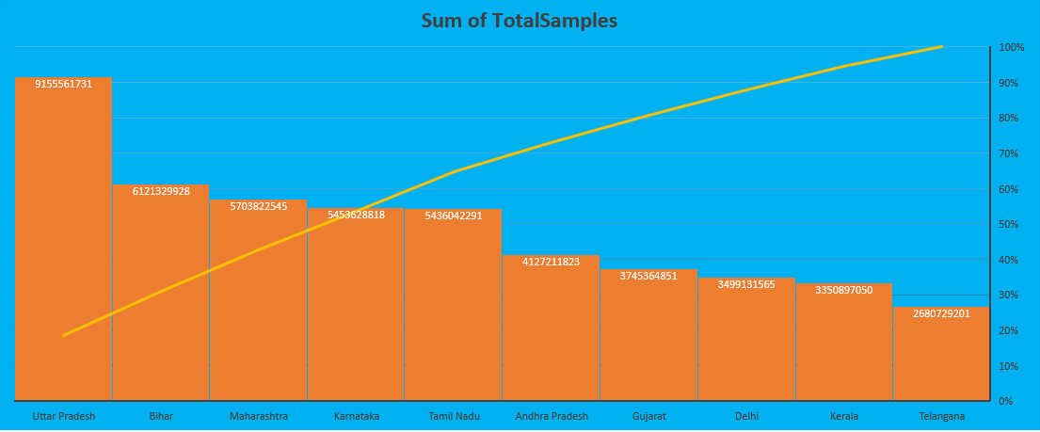
Top 10 states with highest number of Total Samples

Slide 6
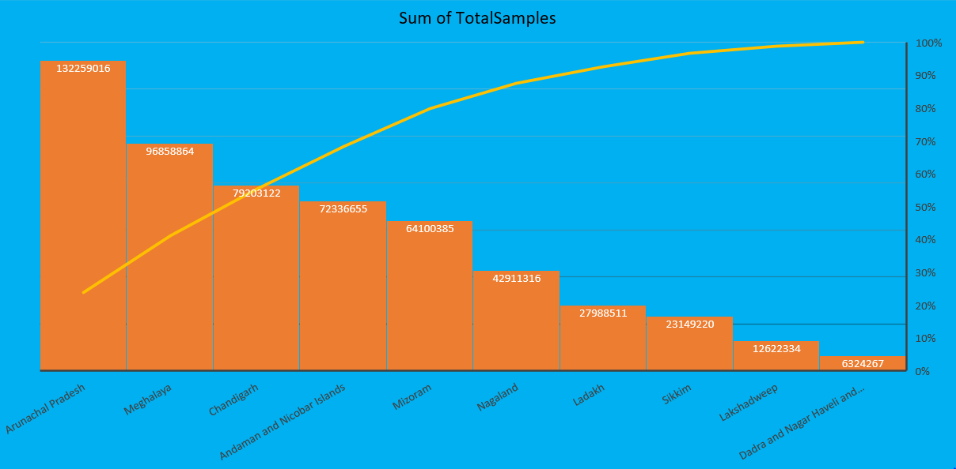
Bottom 10 states with highest number of Total Samples

Slide 7
Top 10 states with highest number of Positive cases

Slide 8
Bottom 10 states with highest number of Positive cases

Slide 9
Top 10 states with highest number of Negative cases

Slide 10
Bottom 10 states with highest number of Negative cases

Slide 11
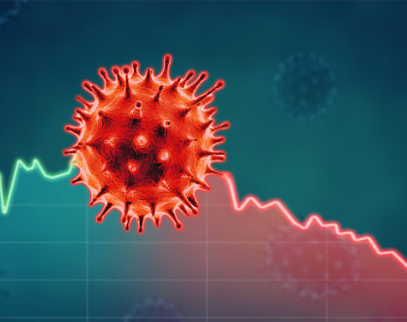
Covid-19 in India
*Active cases
*Cured/ Discharged
*Deaths

Slide 12
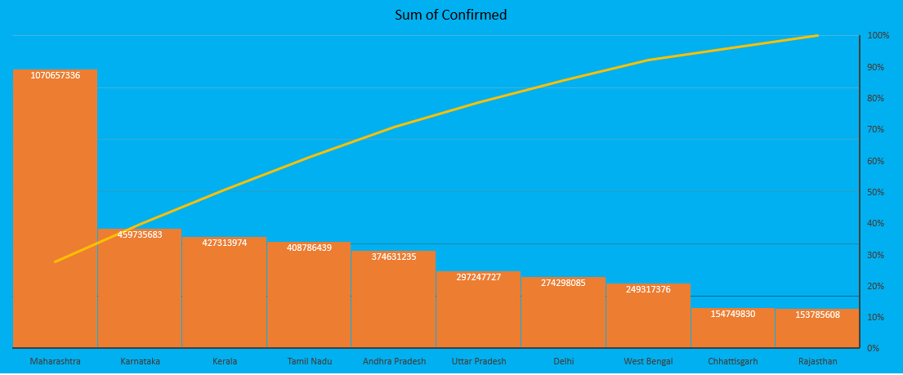
Top 10 states with highest number of Confirmed cases

Slide 13
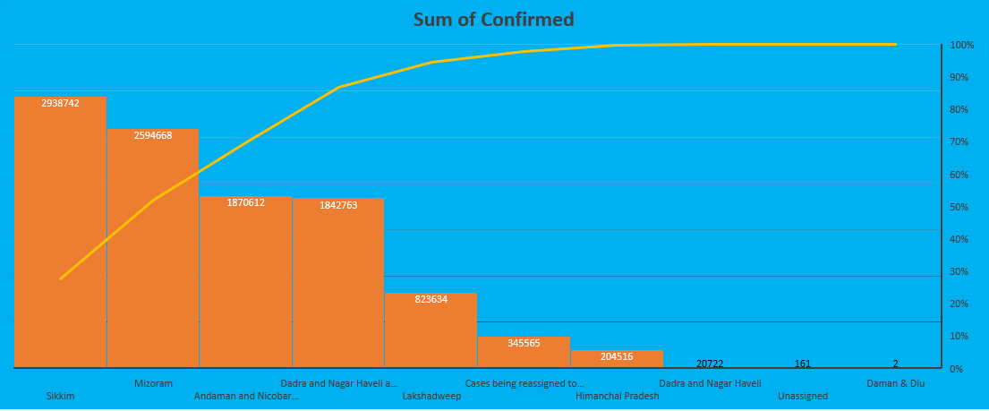
Bottom 10 states with highest number of Confirmed cases

Slide 14
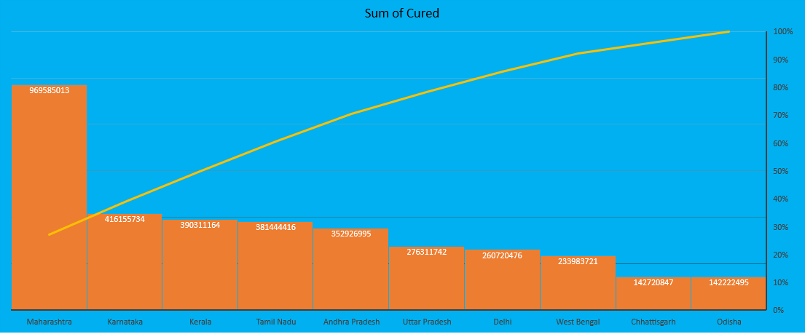
Top 10 states with highest number of Cured cases

Slide 15
Bottom 10 states with highest number of Cured cases

Slide 16
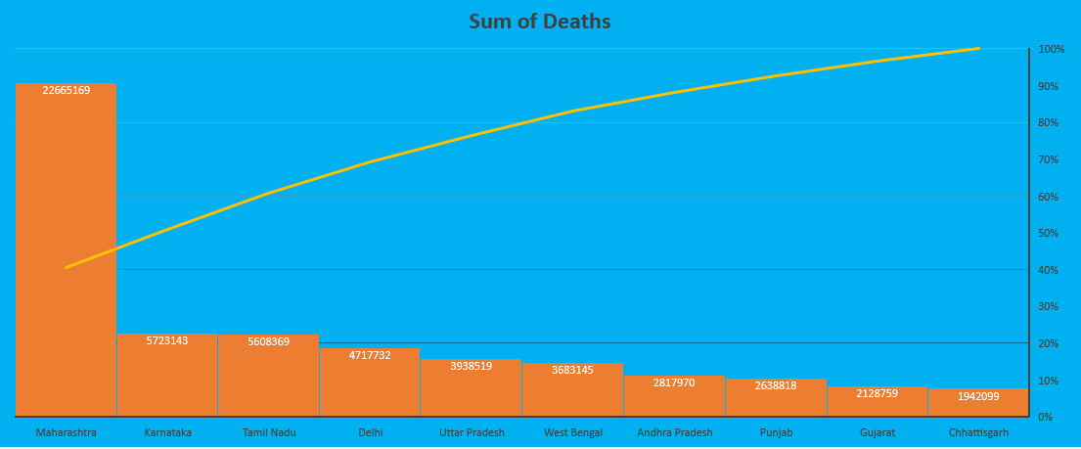
Top 10 states with highest number of Deaths

Slide 17
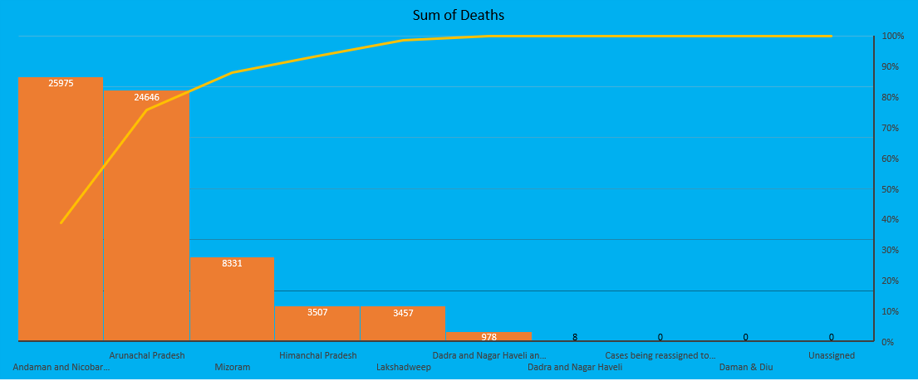
Bottom 10 states with highest number of Deaths

Slide 18
Top 10 states with highest of Death percentage

Slide 19
Bottom 10 states with highest of Death percentage

Slide 20

Covid_vaccine_state wise
*Male and Female Vaccinated ratio for Covid19
*Covaxin and Covishield Vaccination
*Doses administered vs People Vaccinated

Slide 21
Male and Female Vaccinated ratio for Covid19

Slide 22
Male and Female Vaccinated

Slide 23
Covaxin and Covishield Vaccination ratio

Slide 24
Covaxin and Covishield Vaccination

Slide 25
Doses administered vs People Vaccinated ratio

Slide 26
Doses administered vs People Vaccinated

Slide 27
Acknowledgements
Thanks to Indian Ministry of Health & Family Welfare for making the data available to general public.
Thanks to covid19india.org for making the individual level details, testing details, vaccination details available to general public.
Thanks to Wikipedia for population information.
Thanks to the Team at ISIBang
Photo Courtesy - https://hgis.uw.edu/virus/

Slide 28
Inspiration
Looking for data based suggestions to stop / delay the spread of virus

